Slide 1

COURSE REGISTRATION SYSTEM
PRESNTER : GROUP 2

Slide 2
What was planned for me?
The Pre joining Program to make us project ready
Started after the warm welcome by IBM and a fun activity.
Read the pre reads of the topics of the pre learning program.
Had some prior knowledge of the industry standard working principles.
Some knowledge of the tools and technologies used in production.
In the end, now I’m confident that I’m project ready.

Slide 3
Framework for 6 Weeks
6 weeks plan (2022, 10th May - 2022, June 23rd)
Everyday Discussion about cool industry Tools / Technologies and Doubt clearance.
Discussion of Project progress & transformation based on UML & Technologies happened every day with SME.
Started every morning session with review of progress report of project along with debugging and error solving if there’s any.
Every session ends with a crystal-clear description of the tasks that needs to be performed for project development.

Slide 4


Slide 5
6 WEEKS OF TRAINING + PROJECT DEMO
30 DAYS
720 HOURS
43,200 MINUTES
25,92,000 SECONDS
LIMITLESS KNOWLEDGE

Slide 6

Agenda
01
Our Journey
02
Our Team
03
Team Structure
04
Project Goals
05
Engineering Practices
06
Tech Stack
07
Development
08
Challenges & Learnings
09
Demo
10
Questions
Notes:
Time – 1 min

Slide 7

OUR JOURNEY

Slide 8
Project Demo
5
Developement Adaption
4
Design Thinking
3
Decide the Technology
2
Understanding Project
Goals
1

Slide 9

OUR TEAM

Slide 10

Nishant Chaudhari
Kirubakaran A
Ravikumar Lakshatwar
Shubham Choudhary
Group 2
Raghavendra
Penke Hemanth Kumar

Slide 11

PROJECT GOALS

Slide 12




Our Vision
1
2
To create a Course Registration System using JAVA/REST tools and technologies.
We will have multiple modules such as a professor, student and admin.
The major goal is it make the interaction among these modules in such a way that the purpose is served.
Another goal is to ensure the quality, security, interactivity, accessibility and speed in the application.
Quality
Security
3
4
Interactivity
Speed
Notes:
User satisfaction and brand value

Slide 13

Adapting the Best Engineering Practices
Notes:
Time – 5 mins

Slide 14
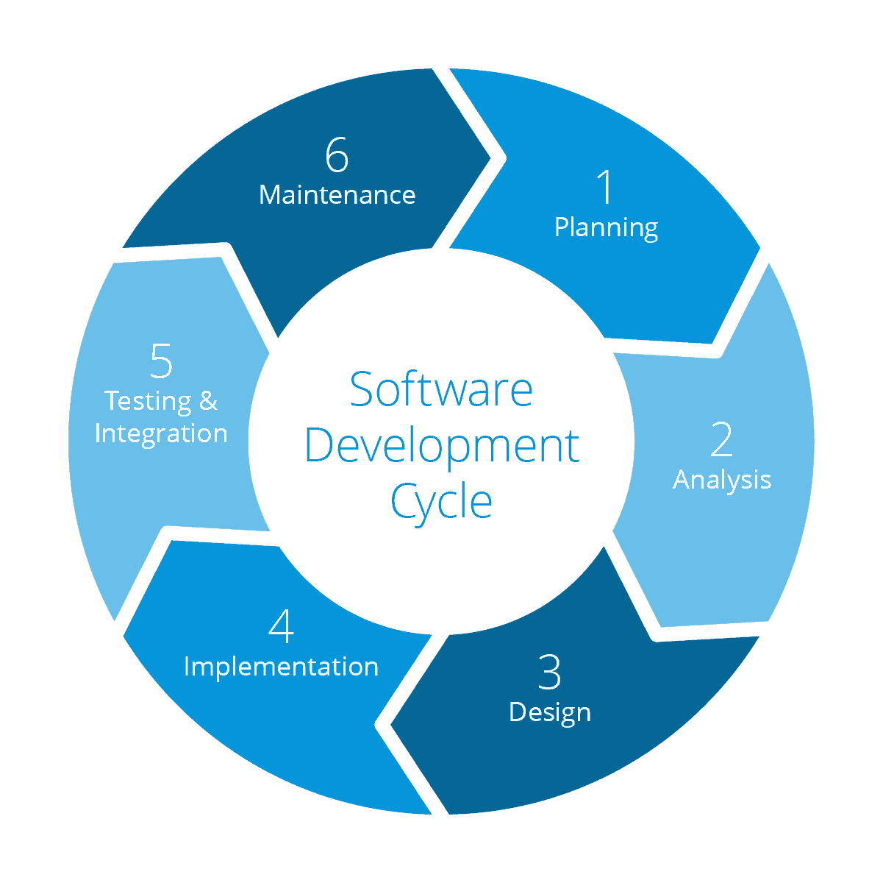
Product Maintenance
Requirement gathering
System Testing
Technology stack selection
Code implementation
and development
UML artifacts design

Slide 15
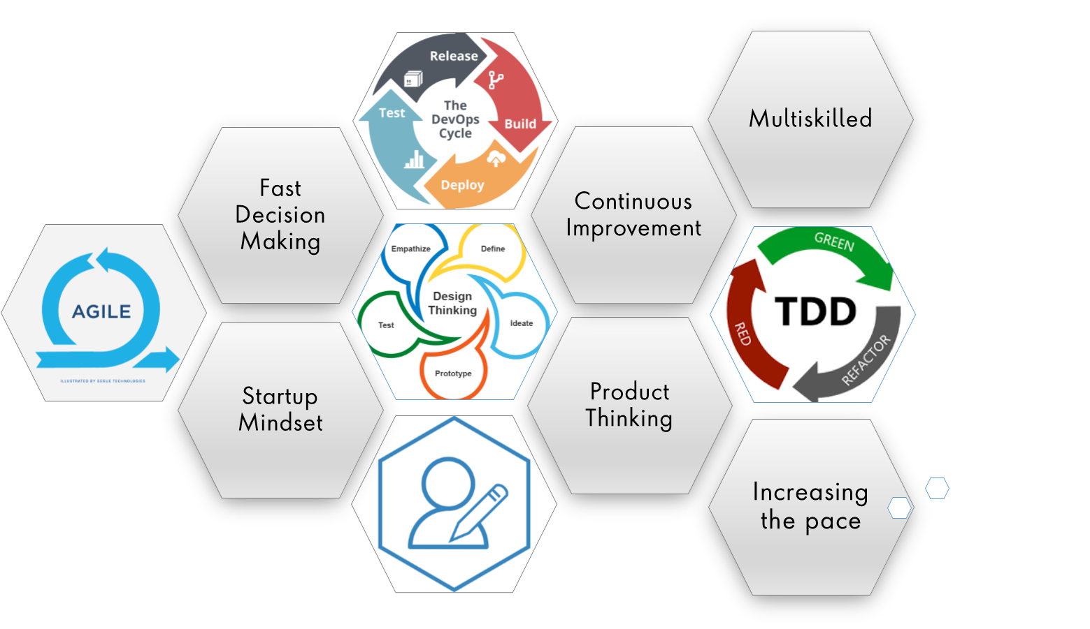
Notes:
Product Thinking (Design Thinking, Requirement Analysis, )
Multi Skilled (Frontend, Backend, DevOps)
Fast Decision Making (Agile)
Increasing the Pace (Automation CI/CD)
Startup Mindset (Agile)
Continuous Improvement (Retros)

Slide 16
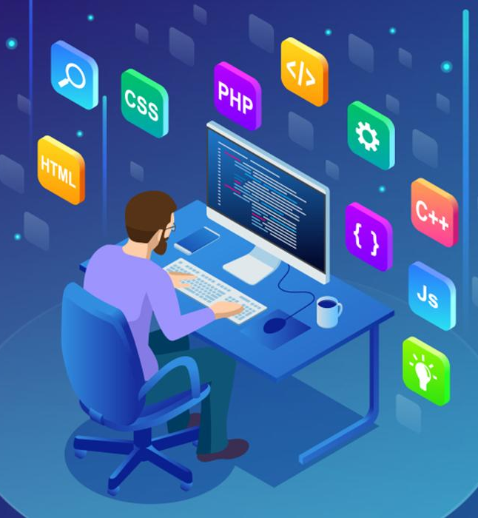
Tech Stack
Notes:
Time – 2 mins

Slide 17










Backend
Data
Tools
Core Language
SQL Database
Documentation
Framework
UI/UX
Version Control
API Testing
Application Server
Notes:
Time – 1 min

Slide 18

Development
Notes:
Time – 1 min

Slide 19
Sprint Process
1. Gathering requirement
2. Resource Planning
Requirement understanding
Research and analysis
Estimation
Sprint Planning
Spring Grooming
Delivery
Sprint Implementation
LLD
Development
Code Review
Commit
Integrate
Deploy
Test
Notes:
Time – 1 min

Slide 20
UML Artifacts

Slide 21
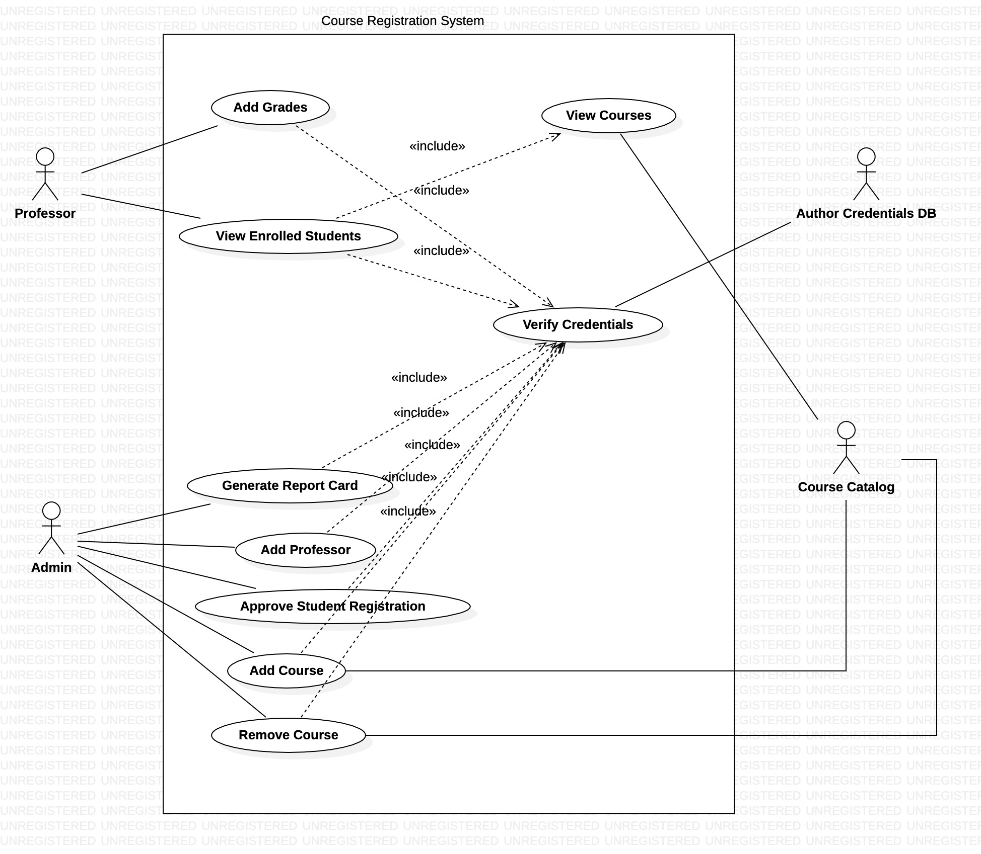

Slide 22
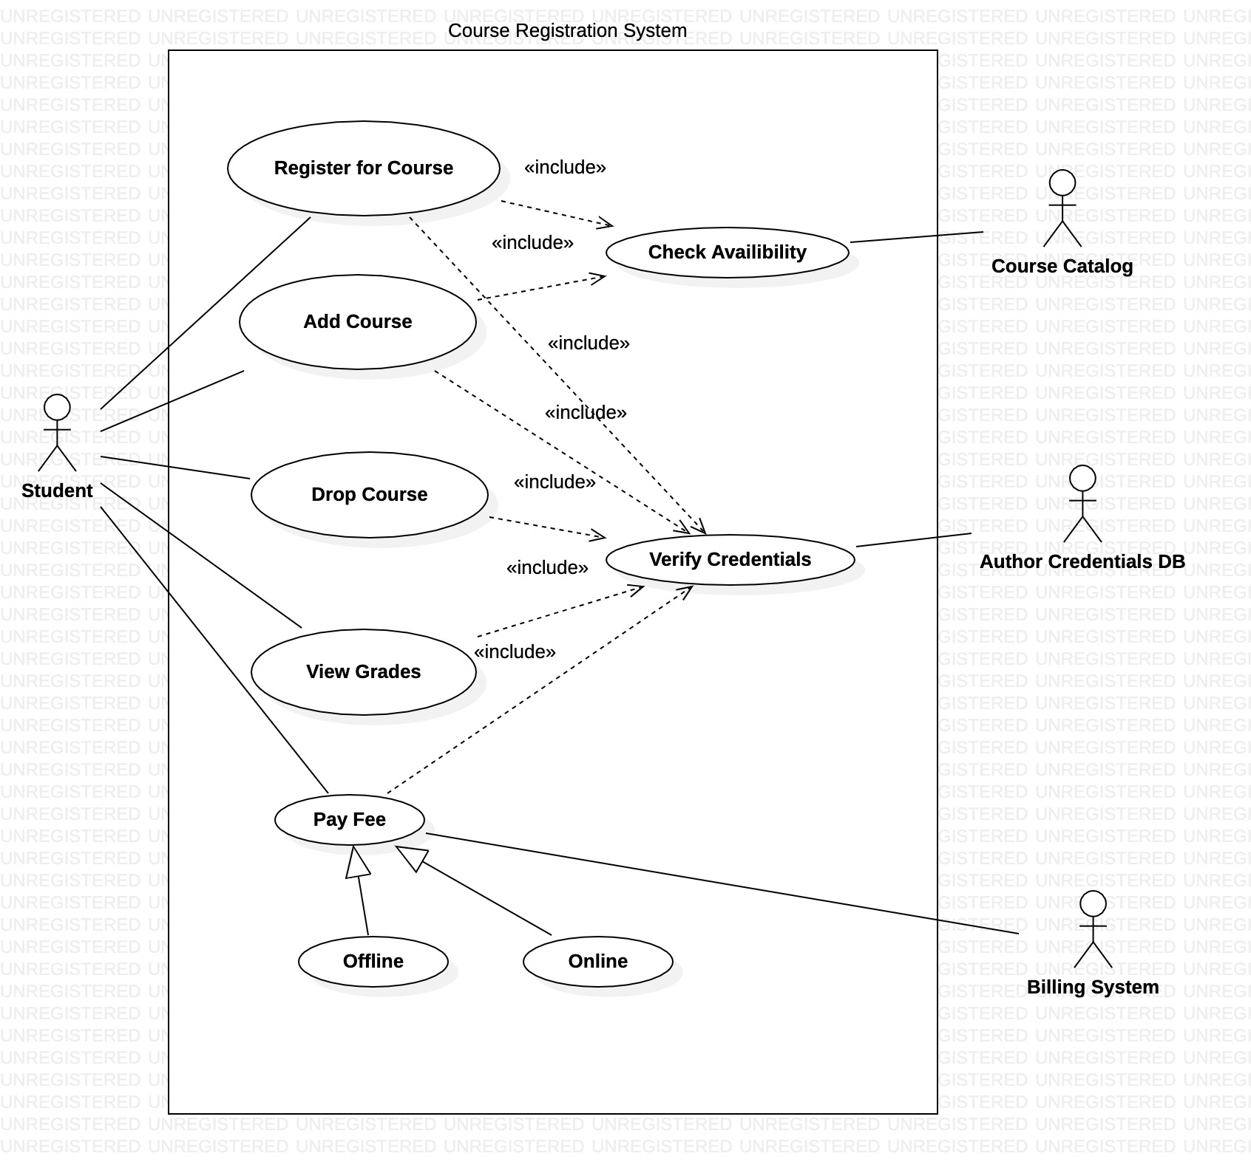

Slide 23
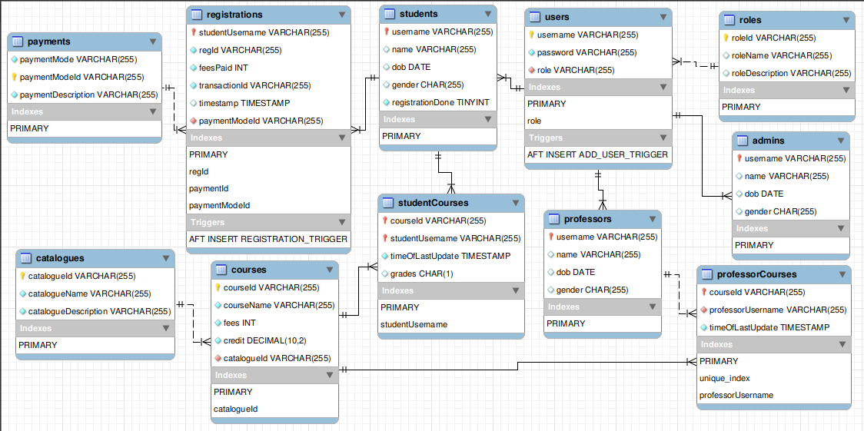
Database Schema

Slide 24
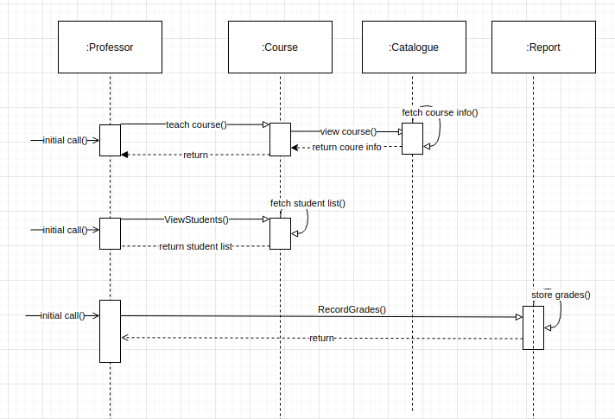
Sequence Diagram-Professor

Slide 25
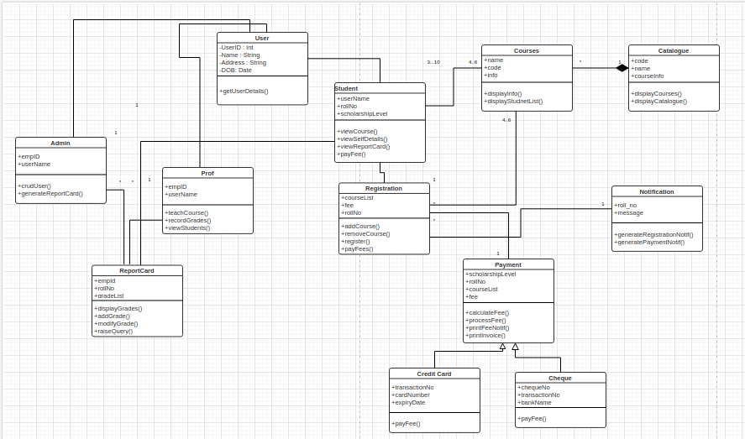
Class Diagram

Slide 26
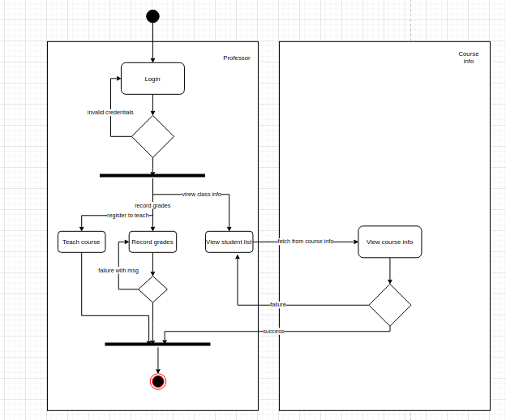
Activity Diagram Professor

Slide 27

Project Demo
Notes:
Time –
POS- Student -5 min
REST - Professor - 3 min
DropWizard- 3 min

Slide 28

Challenges & Learnings
Notes:
Time – 2 mins
Challenges-
Installing the Tomcat server and running application on it.
Learnings-
Got to learn new technologies.
Learnt working together in teams.(collaboration)
Learnt how to write code which is accepted by the industry.
Learnt how to make UML diagrams for the given problem.

Slide 29
CHALLENGES
● Virtual Learning Experience.
● Setting the environment.
● Initially had trouble in designing UML diagrams.
● Creating database and tables.
● Challenge while searching for errors and resolving them.

Slide 30
LEARNING
● Learning can happen virtually too.
● Crystal clear thought process in designing UML diagrams.
● Setting up the environment.
● Better at writing clean and readable codes.
● Learn to use production technologies.

Slide 31

Q & A
Notes:
Time - ?

Slide 32


